Slide 1

Data Analysis and Insights
for Case Study Problem
[Bank Data Warehouse]
Presentation by Kwabena Owusu Asante

Slide 2

Case Study Overview
The Consultant
Agenda
Process
Data Analysis & Insights
Summary

Slide 3
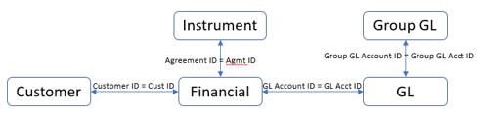
01
Case Study Overview
Case Study Problem Statement:
In the attached excel sheet (Bank Data Warehouse.xlsx), there are 5 tables as:
Customer – This contains the customer information.
Instrument – This contains the loans information.
Financial – This contains the transactions for the loans.
GL – This contains further information about the transactions.
Group GL – This contains the grouping information for the GL transactions.

Slide 4
02
Case Study Overview
Case Study Tasks
What you need to do?
Read and profile the data. Explain your understanding about the data and provide insights.
Explain the assets and off balances for each customer sector category.
Explain the total amount for each sector category before and after adjustment. Hint: Adjustments have “ADJ” text in Source attribute.
Explain the amounts aggregated on countries. Show which country has maximum assets per NACE code and sector category.
What are the total assets for missing Customer Responsible Unit? Can you find any trend from customer or instrument perspective?
Considering the rating/scores as below priority order:
“6+”, “6-“, “6” - Highest rating
“0+”, “0-“, “0” – Lowest rating (Defaulted)
“A+”, “A-“, “A” – Highest score
“0+”, “0-“, “0” – Lowest score (Defaulted)
U – Unassigned
Explain identified anomalies with performance of instruments.
7. Explain any other observation about the data.

Slide 5
03
Case Study Overview
The goal of this case study is to analyze and provide insights from a dataset containing five tables in the Bank Data Warehouse dataset. These tables include customer information, loan details, financial transactions, general ledger data, and grouping information for transactions. The analysis involves profiling the data, understanding asset distributions, adjustments, country-wise aggregations, missing data trends, and performance anomalies based on ratings and scores.
Data Model below :
Country
A new table Country was created to include country names and continent information using the ISO alpha-2 standard. This was done to derive country names and categorize them further into continents, enhancing the clarity of country and region-specific analyses.

Slide 6
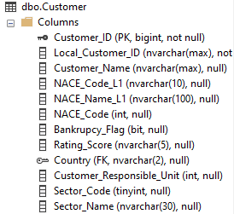
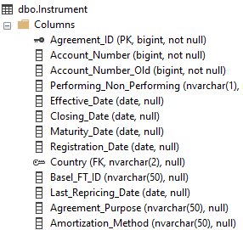

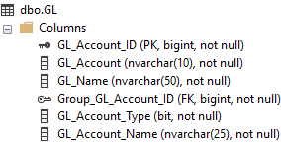
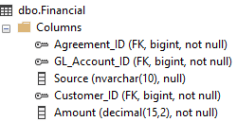

04
Case Study Overview
Data Model with tables :

Slide 7

05
The Consultant
Professional with 12+ years of diverse background in Banking and Finance (Credit Risk & iT Support), Data Analysis and iT Consultancy
Blend of technical, functional, client, consulting, and business management skills
Proven ability to relate to all organizational levels
Consistently add value through initiatives that increase revenue & enhance efficiency, and improve staff productivity
Dedicated to leveraging expertise to deliver impactful solutions for business growth

Slide 8
06
Process
Data Profiling and Understanding
Table Creation for Data Model
Addressing Case Study Tasks
Data Analysis and Insights

Slide 9
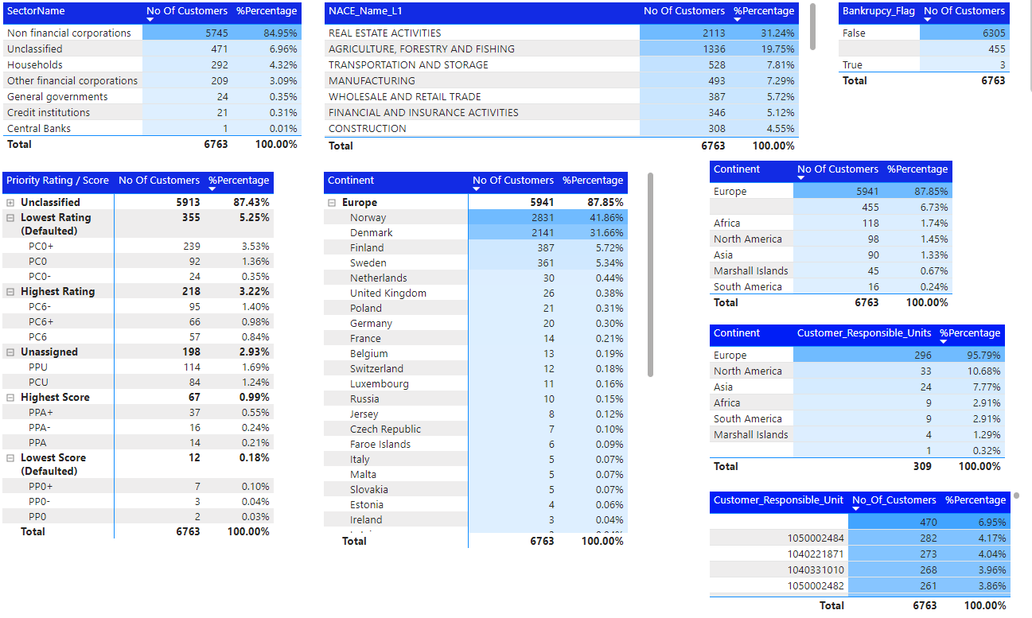
07
Data Analysis & Insights [Customers]

Slide 10
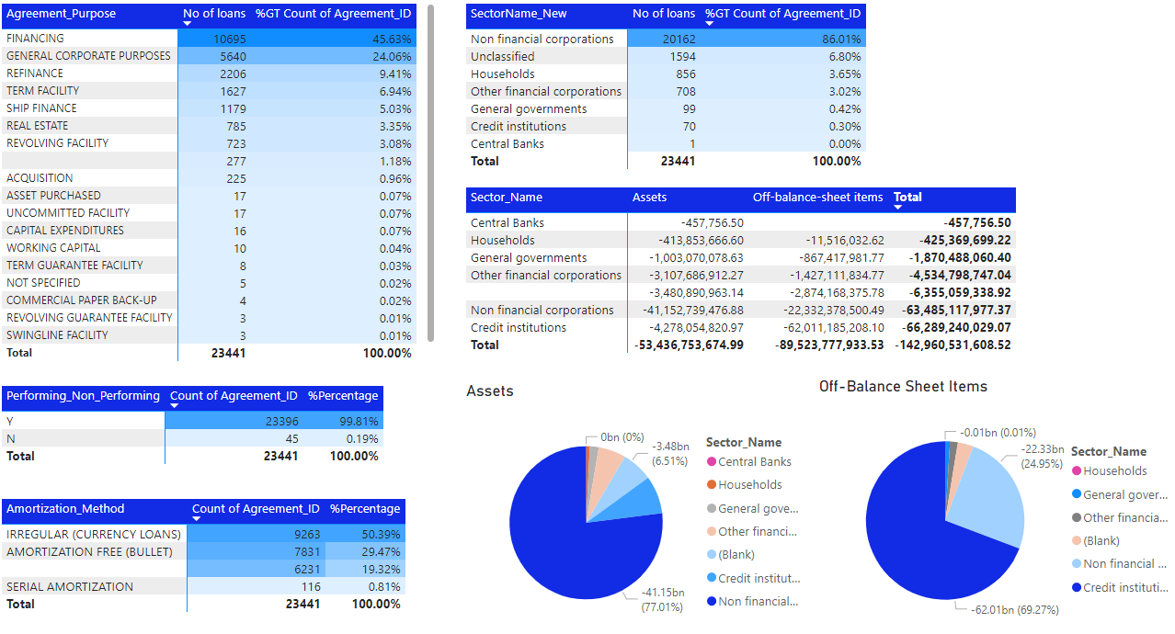
08
Data Analysis & Insights [Loans]

Slide 11
Strong customer presence in Europe.
Significant lending in real estate and agriculture sectors.
Stable and reliable customer base: over 90% of loans are performing, and there are low bankruptcy rates among customers.
Need for improved data management: the presence of NULL values in datasets suggests data quality issues, which are essential to address for robust risk management strategies.
Invest in data analytics expertise to extract valuable insights, improve financial reporting, and enhance regulatory compliance.
Summary

Slide 12
Thank You
Presentation by Kwabena Owusu Asante

